Slide 1


Abstra
Lazar Milicevic
Weekly support report
Support, Challenges, Solutions
08.04.2025

Slide 2
Agenda
1. Operational Performance and Metrics
3. Documentation and Knowledge Management
5. Challenges & Solutions
7. Q&A
2. Platform and Tooling Enhancements
4. User Behavior & Analytics
6. Next Steps & Focus Areas

Slide 3
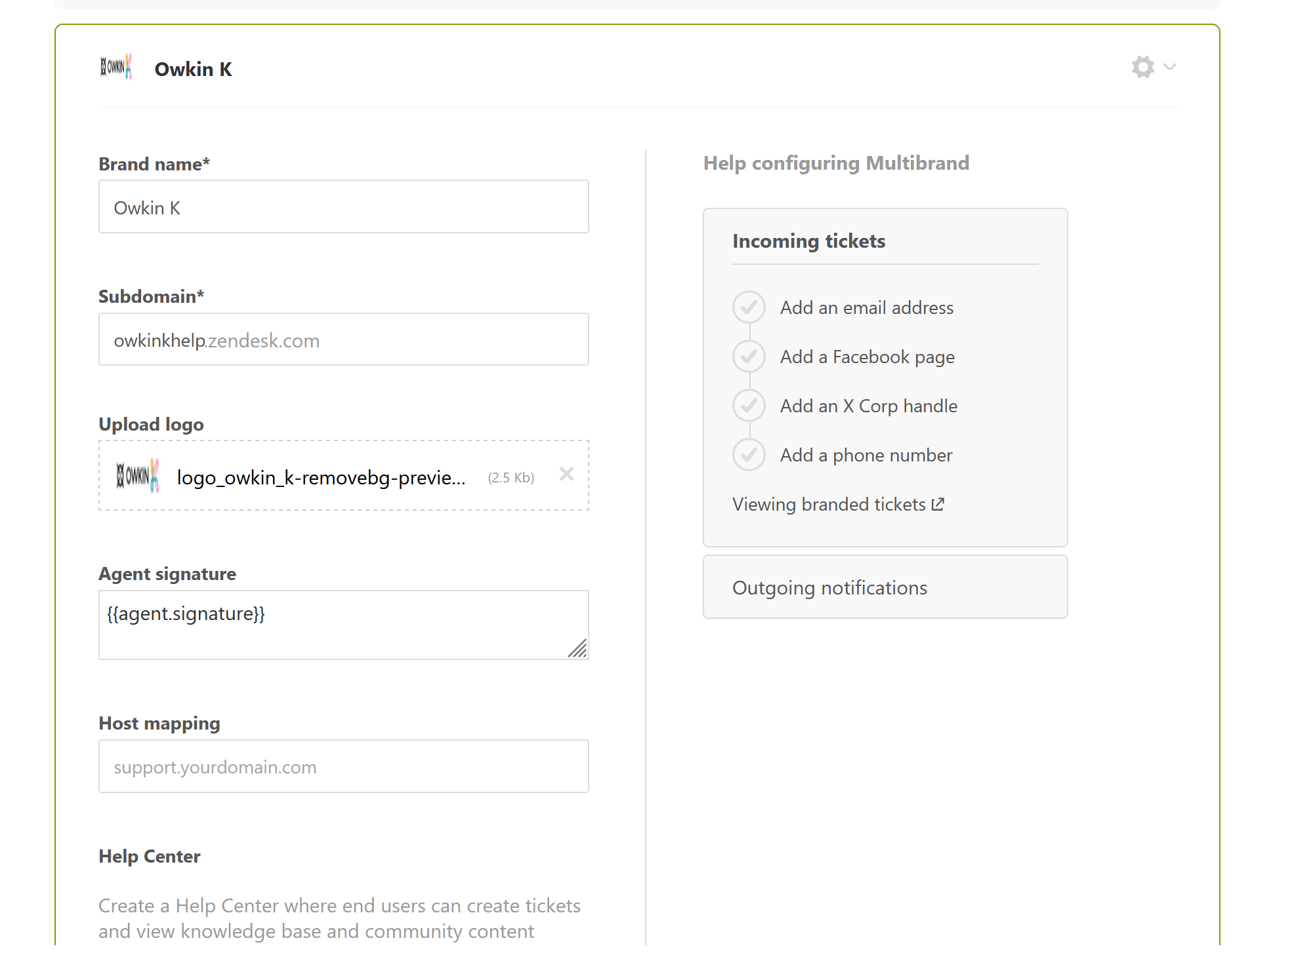
Operational Performance and Metrics
Customer success: Weekly Support Report – 08.04.2025
What was done:
✅ The support team maintained strong performance this week, with excellent responsiveness and high customer satisfaction across all channels.
First Response Time: We kept the average FRT under 5 minutes for all incoming tickets, with Owkin K-related requests receiving immediate attention.
Ticket Volume: A total of 254 tickets were handled during March, marking a 23% increase compared to February.
Resolution Time: The average resolution time dropped to 3.9 hours – a 42% improvement – demonstrating improved triaging and issue handling across the board.
Customer Satisfaction (CSAT): We maintained a 100% satisfaction rating for the second consecutive month, based on feedback collected via Zendesk and the new SurveySparrow widget.

Slide 4
Platform and Tooling Enhancements
Customer success: Weekly Support Report – 08.04.2025
What was done:
✅ A number of improvements were made to our tooling and support infrastructure to streamline workflows and elevate the user experience:
SurveySparrow Implementation: Completed coordination, testing, and production deployment of the SurveySparrow NPS tool. The widget is now live on the Owkin K website, capturing real-time user sentiment and feeding directly into our analytics pipeline.
Zendesk Enhancements:
  Created a dedicated support group for the Owkin K team in Zendesk.
  Configured accounts and access for new QA tester, Ahcene Maouche.
  Maintained low Resolution time by manually triaging and reproducing issues before escalation to L2.
  Initiated development of the “3-strike rule” logic to auto-close stale tickets and reduce agent load — expected to go live this week.
Branded Help Center Communication: Setup initiated for branded email responses in the Help Center. We are currently waiting on account credentials from IT to proceed.

Slide 5
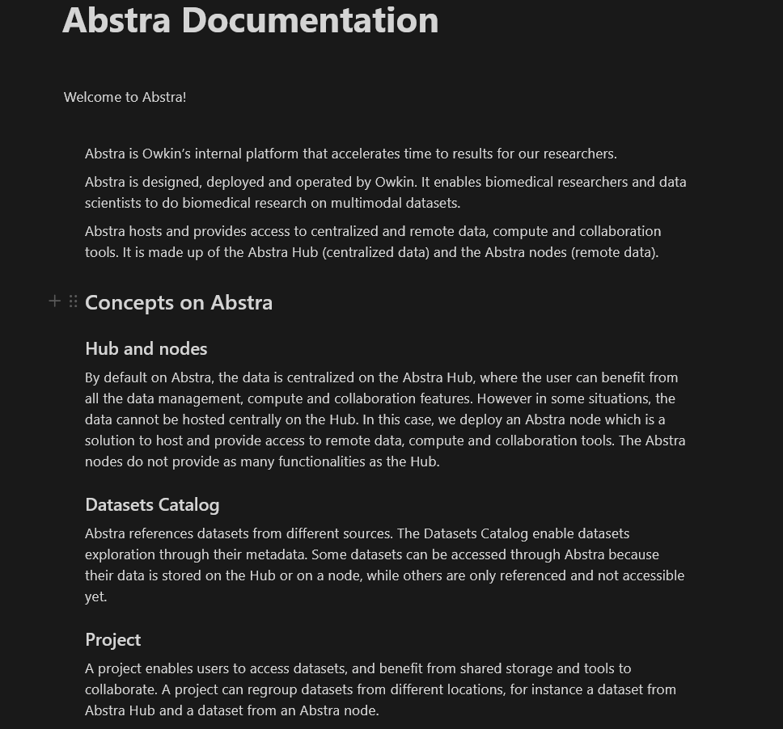
Documentation and Knowledge Management
Customer success: Weekly Support Report – 08.04.2025
Where we are now ?
✅ Migrated the complete Abstra documentation to Notion.
This included:
Creating a structured Table of Contents.
Using collapsible toggle blocks for ease of navigation.
The draft version is already available and partially in use.
Work is still ongoing to finalize image transfers and visual refinements.

Slide 6
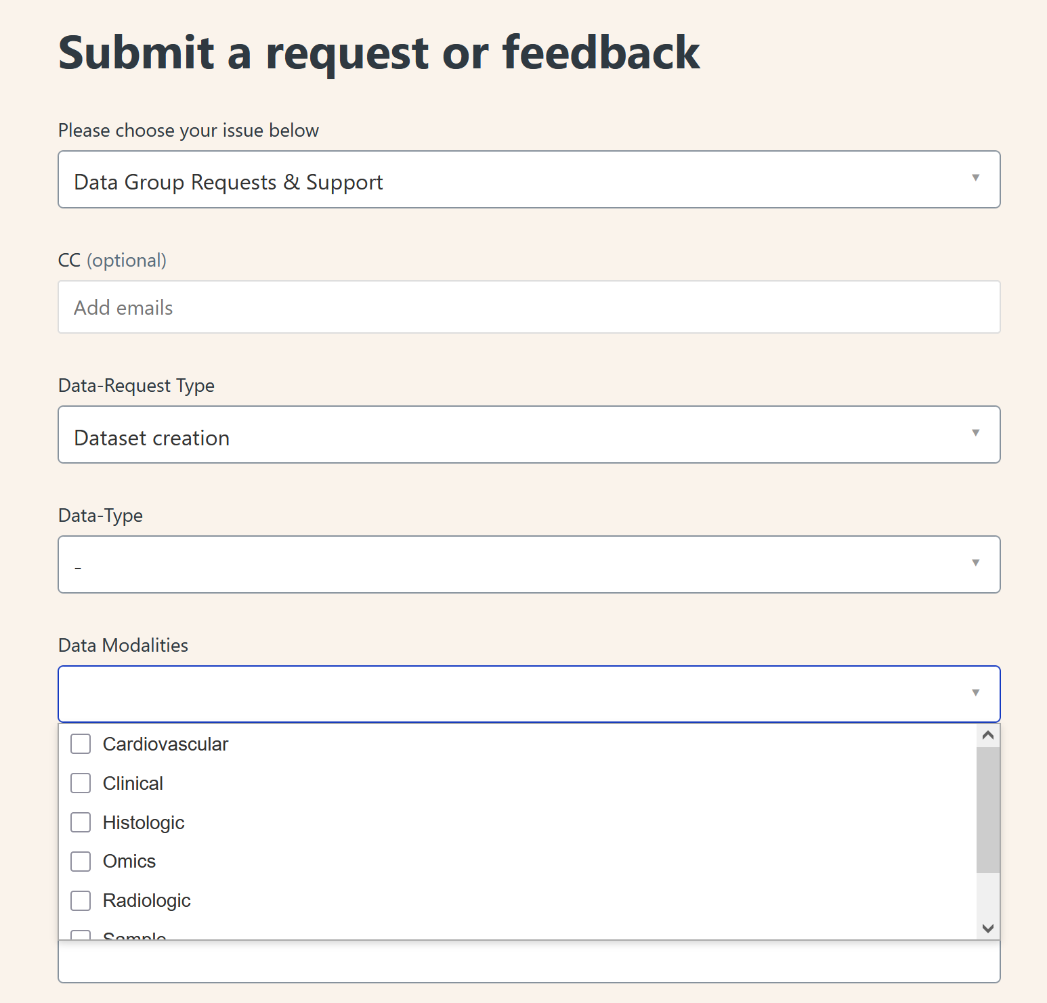
User Behavior & Analytics
Customer success: Weekly Support Report – 08.04.2025
Where we are now ?
✅ Launched the new FullStory dashboard for Owkin K, designed to give cleaner insight into user sessions, behavior trends, and pain points.
Identified an inconsistency in unique user tracking, caused by unstable User ID assignments across sessions.
This results in inflated user counts and incorrect behavioral data.
After reviewing FullStory’s documentation and confirming with frontend (Jeremy), a session has been scheduled with the FullStory Account Manager for April 15 to resolve the issue.
Additional testing is ongoing to assess whether supplementary metadata could help mitigate the issue in the short term.

Slide 7
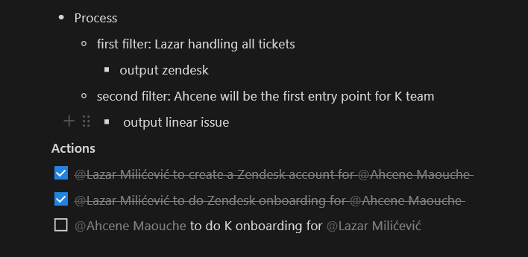
Collaboration and Onboarding
Customer success: Weekly Support Report – 08.04.2025
Some of them:
✅Held a coordination sync with Samuel Lesuffleur and Ahcene Maouche to align on Owkin K support.
Had an Zendesk onboarding session for Ahcene..
Continued to support QA workflows by enabling triage-first troubleshooting on tickets prior to escalation to L2 teams.

Slide 8
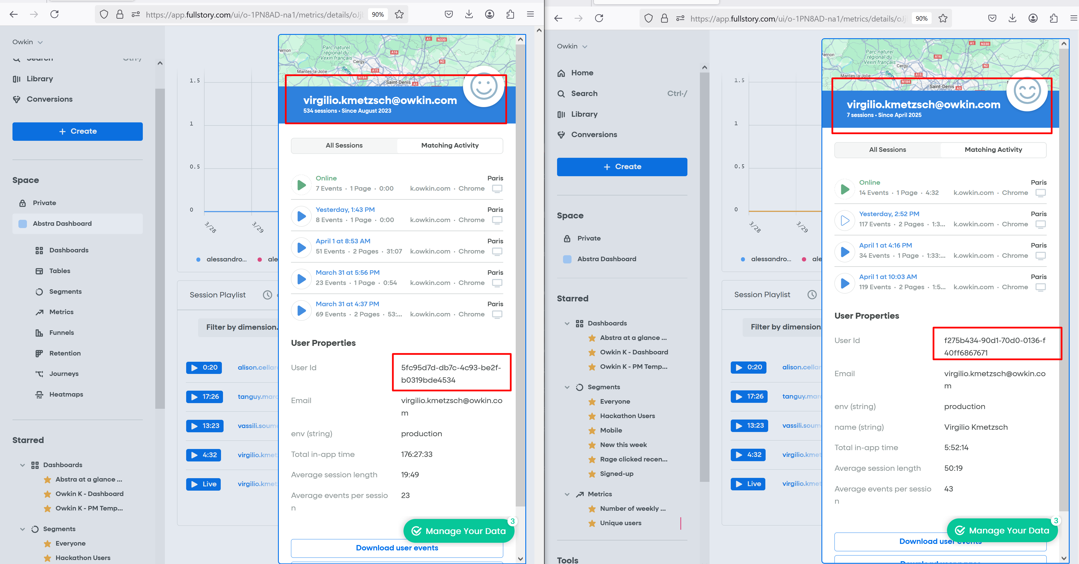
Challenges & Solutions
Customer success: Weekly Support Report – 08.04.2025
What will be done:
Inconsistent User ID Assignment in FullStory
Challenge: FullStory's unique user count is inaccurate due to inconsistent User ID values being assigned across sessions.
Solution: Root cause identified after internal review and confirmation with frontend. Meeting scheduled with FullStory Account Manager on April 15 to implement a long-term fix. In the interim, we're testing the addition of custom parameters to improve accuracy.
2. Limited Zendesk Agent Licenses
Challenge: Need for additional agent accounts to onboard QA team member, while keeping license count within current quota.
Solution: Reached out to team to check for unused licenses that can be reassigned. One license has already been requested for immediate reassignment.
3. Ticket Resolution Overload
Challenge: Growing number of low-priority tickets remaining open, increasing workload and affecting closure rates.
Solution: Implementation of a “3-strike rule” logic to automate resolution of inactive tickets is underway. Expected to go live early this week.

Slide 9
Next Steps & Focus Areas
Customer success: Weekly Support Report – 08.04.2025
What will be done:
1. Finalize Zendesk Ticket Closure Logic
Continue work on the automated 3-strike policy to streamline closure of dormant tickets and reduce agent fatigue.
2. Launch Branded Email Support in Help Center
Pending IT credential delivery. Once active, users will receive consistent, on-brand communications from our Zendesk system.
3. Complete Documentation Migration to Notion
Finalize image upload and formatting of the new Abstra documentation in Notion. Ensure easy navigation and regular version control.
4. Improve FullStory Data Accuracy
Post-meeting with FullStory, implement recommended fixes to unify User ID tracking and reduce skew in behavioral metrics.
5. Zendesk Centralization Initiative (April)
Prepare Zendesk to become the central intake point for all ticket types across Owkin platforms. This includes updated routing rules, team assignments, and escalation flows.

Slide 10

Q&A
Customer success: Weekly Support Report – 25.03.2025
?

Slide 11
Thank you!

